Slide 1

P peline
The Data
Byte 1: Fusion Tables
© Jennifer Mankoff
The Data Pipeline; HCII; Spring 2014

Slide 2
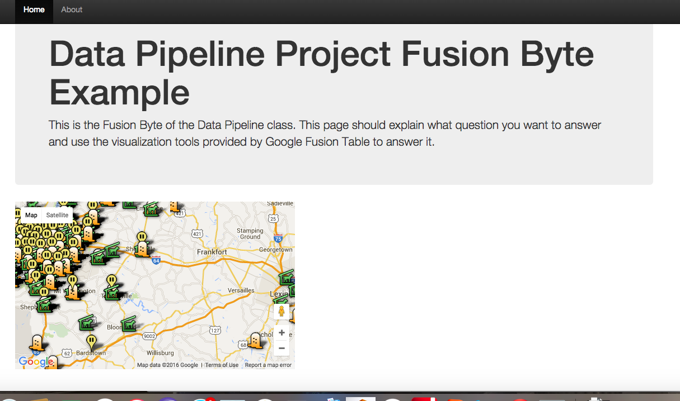
Let’s look at Byte1
Learning goals:
A first experience with Python/Appspot
Setting up a question and deciding what data helps to answer the question.
http://jmankoff-fusion.appspot.com/

Slide 3
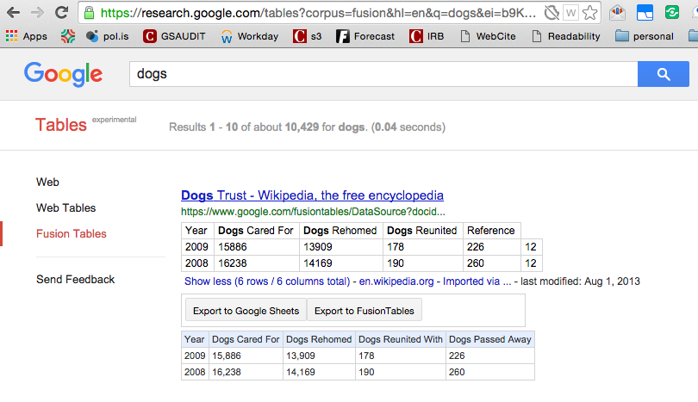
Which Data Table?
https://research.google.com/tables

Slide 4
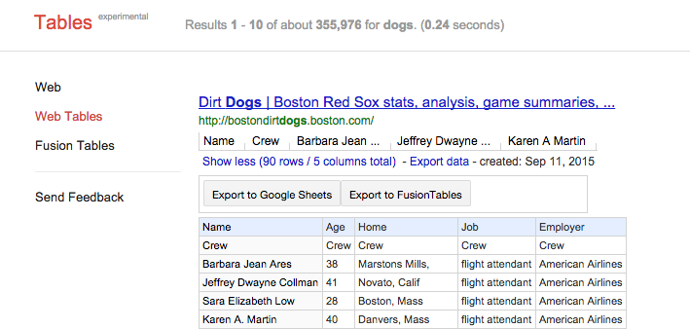
Which Data Table?
https://research.google.com/tables

Slide 5
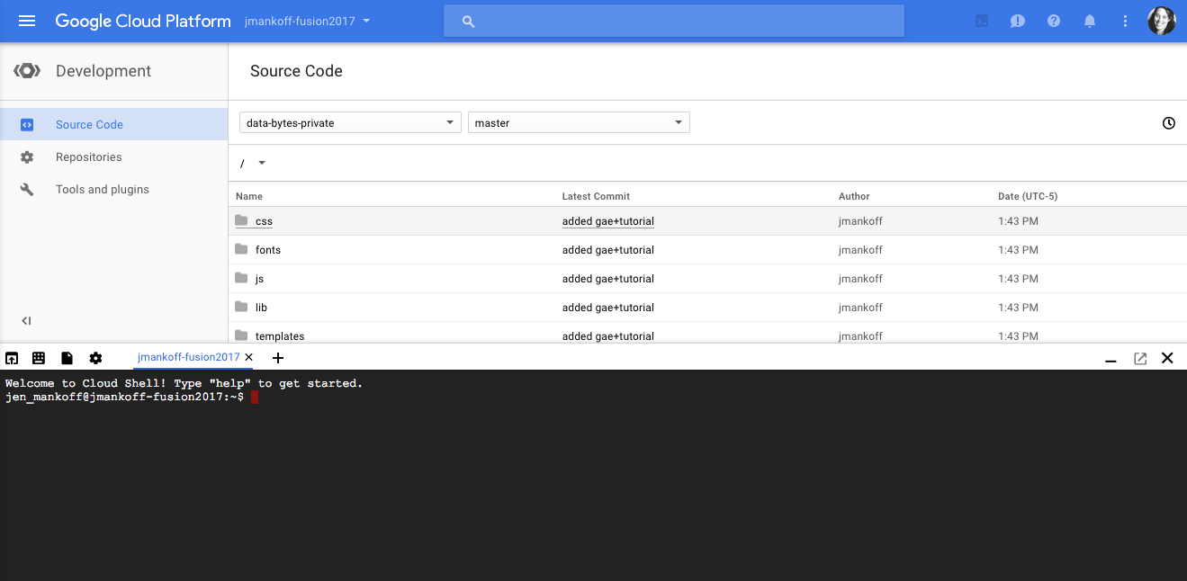
How does Appspot work?

Slide 6
How does Appspot work?

Slide 7
How does Appspot work?

Slide 8
Key commands
gcloud source repos clone python-gae-quickstart --project=jmankoff-fusion2017
Checks out the base code for this assignment which google provides)
dev_appserver.py ./app.yaml
For web preview
gcloud app deploy ./index.yaml ./app.yaml
For handin ([yourbytename].appspot.com)

Slide 9
Hints and Requests
Be sure to follow the tutorials step by step.
Leave enough time to work out the kinks – even with a tutorial and source code you will run into some.
Questions and answers are most welcome as comments on the tutorial so we all benefit.
Most of your time should be spent working on your data and what question you are answering with it
Notes:
----- Meeting Notes (1/14/14 10:13) -----
make sure comments are enabled
make sure th search works with spaces

